Slide 1
DynamoDB

Slide 2
DynamoDB - Basics
DynamoDB is a fully managed NoSQL(Not Only SQL) database service
DynamoDB is made of tables
Each table - primary key (Must be decided at creation time)
Each table - infinite No. of items(Rows)
Each items has attributes
Item – Max size – 400KB
Data Types :
Scalar Types : String, Number, Binary, Boolean, Null
Document Types : List, Map
Set Types : String Set, Number Set, Binary Set
Provisioned Throughput :
Table must have provisioned RCU & WCU
Read Capacity Units (RCU) : Throughput for reads
Write Capacity Units (RCU) : Throughput for Writes
Setup Auto scaling of throughput to meet demand
Throughput can be exceeded temporarily using "burst credit"
If burst credit are empty -->will get a "ProvisionedThroughputException"

Slide 3
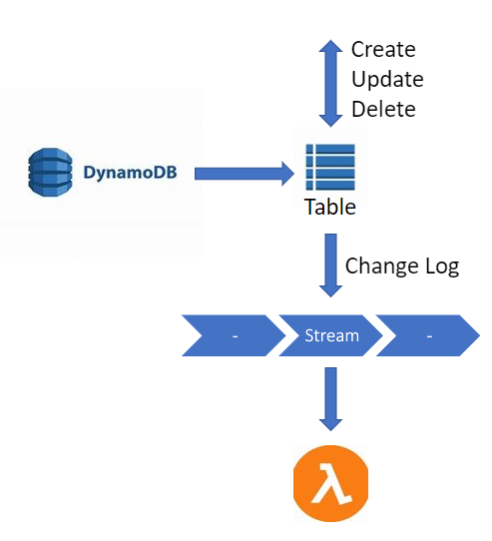
DynamoDB Streams
Changes in DynamoDB (Create, Update, Delete)
This stream can be read by AWS Lambda
Could implement cross region replication using Streams
Stream has 24 hours of data retention

Slide 4
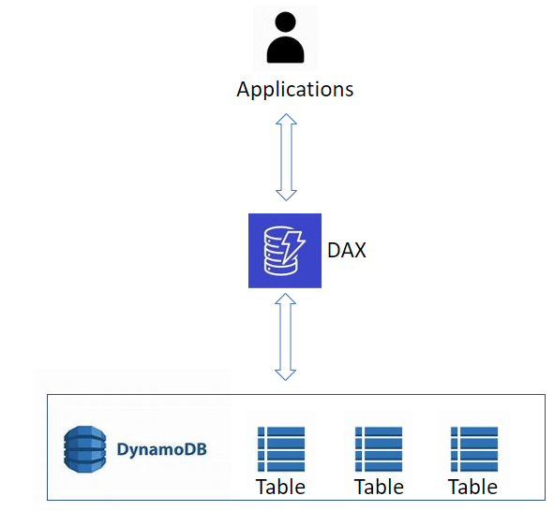
DAX : DynamoDB Accelerator
Cache for DynamoDB, No application re-write
Writes go through DAX to DynamoDB
Microsecond latency for cached reads & queries
TTL --> Default : 5 min. -- for cache
Up to 10 nodes in the cluster
Multi AZ (3 nodes min recommended for
production)

Slide 5
API Gateway

Slide 6
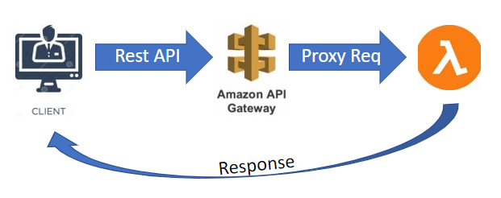
API Gateway
Amazon API Gateway is an AWS service for creating, publishing, maintaining, monitoring, and securing APIs
Stateful --> WebSocket API
Stateless --> HTTP API and REST API
HTTP API :
Collection of routes and methods
Integrated with backend HTTP endpoints or Lambda functions
Deploy this collection in one or more stages
REST API :
Collection of HTTP resources and methods
Integrated with backend HTTP endpoints, Lambda functions and AWS services
Deploy this collection in one or more stages
WebSocket API :
Collection of WebSocket routes and route keys
Integrated with backend HTTP endpoints, Lambda functions and AWS services
Deploy this collection in one or more stages

Slide 7
Cognito

Slide 8
Cognito
To give our users an identity so that they can interact with our application
Cognito User Pools :
--> Sign in functionality for app users
--> Integrate with API Gateway
Cognito Identity Pools (Federated Identity) :
--> Provide AWS credentials to users so they can access AWS resources directly
--> Integrate with Cognito User Pools as an identity provider
Cognito Sync :
--> Synchronize data from device to Cognito
--> May be deprecated & replaced by AppSync

Slide 9
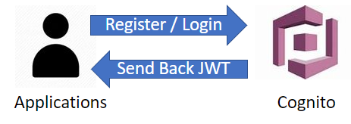
Cognito User Pools
Create a serverless database of user (For mobile apps)
Simple Login : username / email / password
Verify emails / Ph No / add MFA
Can enable Federated Identities (Fb, Google, ….)
Send back a JSON Web Tokens (JWT)
Can be integrated with API Gateway for authentication

Slide 10
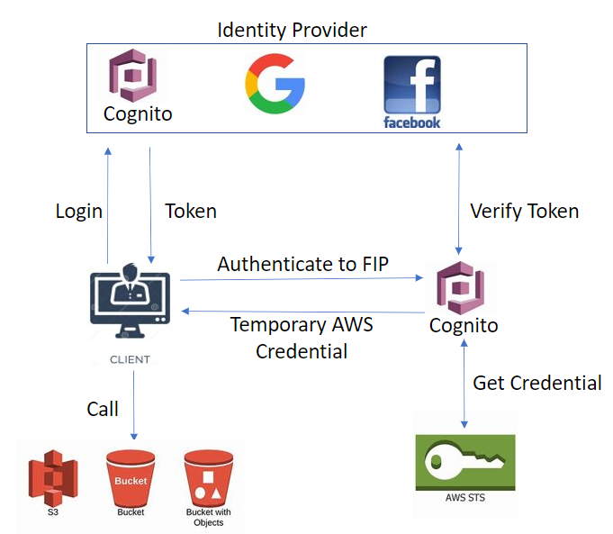
Federated Identity Pools
Goal :
Provide direct access to AWS Resources from client side
How?
Log in to Identity provider
Get temporary AWS credentials back from Federated Identity Pool
These credentials come with a pre-defined IAM policy stating their permission
Example :
Provide temporary access to write to S3 bucket using Facebook login

